Slide 1
Introduction to SCM
Building Landscapes

Slide 2

Agenda
What is SCM
SCM features
SCM Benefits
Case Studies
High level flow
Tooling Landscape

Slide 3


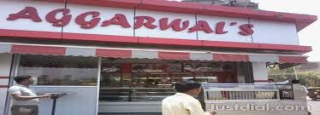
SCM
Notes:
https://hackernoon.com/sreies-part-1-configuration-management-9cfdb4e9e303
https://www.digitalocean.com/community/tutorials/an-introduction-to-configuration-management
the mechanism used to make the server reach a desirable state, previously defined by provisioning scripts using a tool’s specific language and features.
to make sure that the customer’s experience is the same no matter which location they attend.
make sure business partners and I am the only people making decisions that affect the business, this includes shop design, recipe changes, and employee responsibilities, to name a few.
I need to make sure each shop is designed similarly to ensure a consistent customer experience.
I need to make sure each shop gets the proper equipment to run efficiently (oven, pans, pastry bags, cash register, counter space, etc).
I need to make sure all of my recipes are written down and shared with each store location. I also need to ensure that each location gets the same ingredients delivered on time for business.

Slide 4

Features
Automation
Identification
Idempotent behaviour
System Facts
Templating System
Extensibility

Slide 5



Without SCM
Manual Installation
Login and perform installation/config changes ad hoc scripts/tools
Not scalable
Everyone solving same problems their own way boring

Slide 6
Benefits
Increased efficiencies, stability and control by improving visibility and tracking
Cost reduction by having detailed knowledge of all the elements
Enhanced system reliability
Faster problem identification
Decreased risk and greater levels of security.
Faster restoration
Facilitates team coordination.
Notes:
Efficiency, Stability & Control : Do once repeat multiple times without any issues
Cost Reduction : Both in terms of man hour effort spent & cost of bug
System Reliability : No scope of manual error so same behaviour across environment
Problem identification: As everything is in the form of code so easy to identify the problem currently documentation is the way to resolve the prob
Decreased risk: same behaviour across 1 or thousand nodes
Faster restoration: Updates on 1000’s of servers

Slide 7
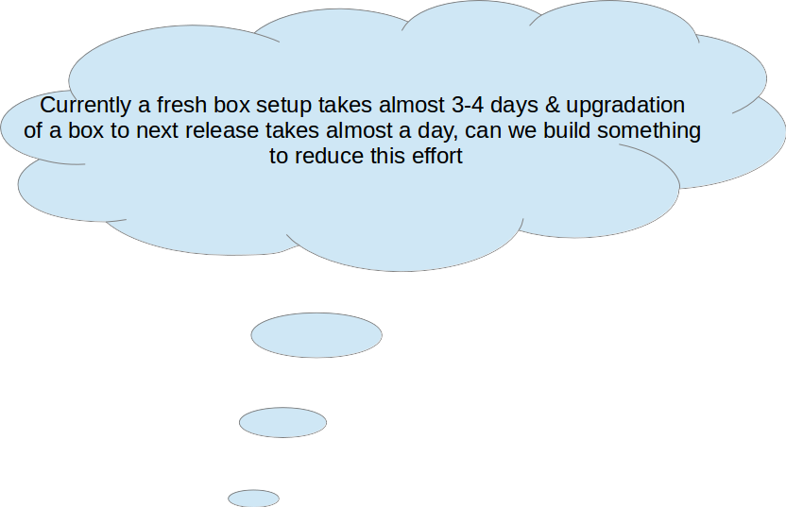

Slide 8
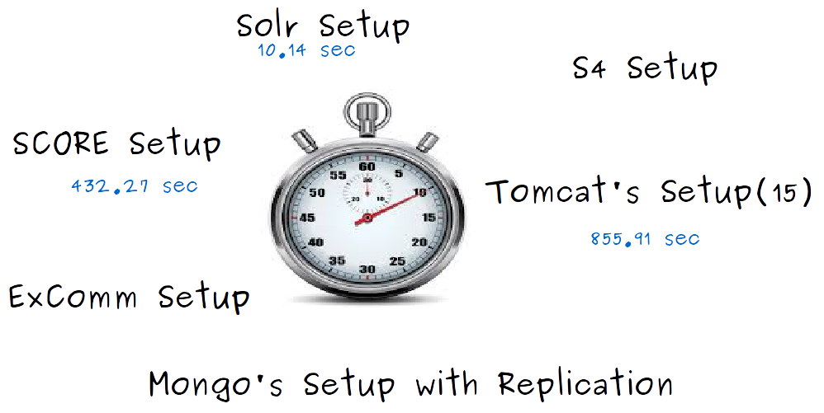

Slide 9
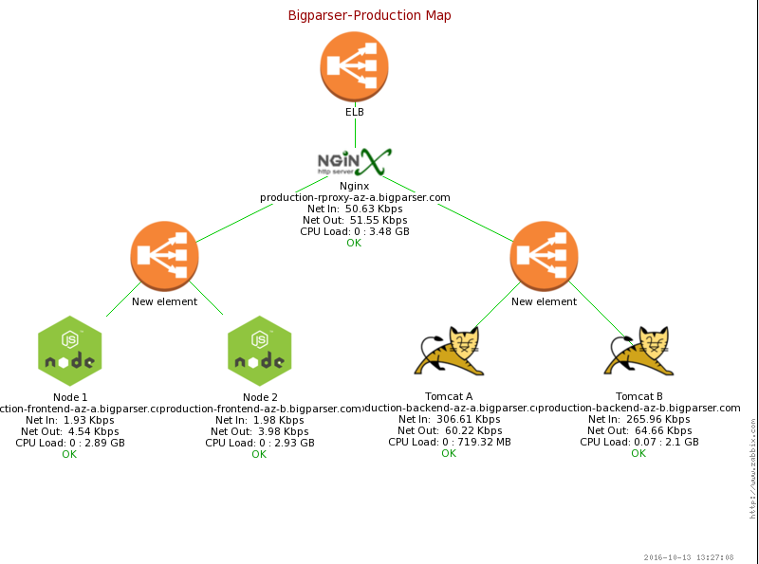
Notes:
Talk about how using SCM we are able to build such a setup in a timeframe of a week only
CI/CD
Softwares
Monitoring

Slide 10

What SCM do ?
SCM activities are developed to:
Identify the change
Control change
Ensure that change is being properly implemented
Report changes to others who may have an interest
Notes:
Introduce the term Idempotency

Slide 11
High level flow ?
Vanilla Server
Your Desired Server
Apply SCM tool
Before
Transformation
After

Slide 12




Tooling Landscape
Notes:
Puppet
Talk about hiera, foreman
Talk about case study of Panthacorp
Talk about convention over configuration
Chef
Talk about it’s architecture flow, Knife, kitchen,
Talk about case study of Barclays
Draw the analogy of Maven & Puppet
Ansible
Talk about why I’m so excted about Ansible how it is different from standard DevOps tools.
Use cases of Ansible
Infra setup
Deployment
Server Administration
Infra Management

